Slide 1
LGPS PRE-RETIREMENT COURSE
Gwynedd Pension Fund & Clwyd Pension Fund

Slide 2


Local Government Pension Scheme
One of the largest public sector pension schemes in the UK with over 4.6 million members.
The scheme is administered locally through 99 regional pension funds. In North Wales, there are 2 funds:
Anglesey County Council
Conwy C B Council
Gwynedd Council
Denbighshire County Council
Flintshire County Council
Wrexham C B Council

Slide 3
Local Government Pension Scheme (LGPS)
Contribution rate between 5.5% and 12.5% of your pensionable pay.
Your employer pays the balance of the cost of providing your benefits. Average contribution rate in both funds is around 19.5%.
Pension contributions attract tax relief (National Insurance relief came to an end April 2016)
The scheme is guaranteed by the Government – Benefits payable dependant on service and pay received rather than on investment returns.
You must be in the scheme for at least 2 years or transferred in other pensions, to qualify for the LGPS pension.

Slide 4
Contributions
Employer decides which contribution banding the member fall into.
Contributions are based on actual pay.
Gaining tax relief.
The bandings are reviewed every April and amended in line with CPI. (Consumer Price Index)
Employers also make a contribution which is determined by our Actuary and reviewed every 3-4 years. This does not affect the pension the member is building up.
50/50 Scheme from 1 April 2014 -pay half the amount of contributions while keeping all benefits of the scheme.

Slide 5
Contribution Bandings
Actual Pay Earned | Conts Rate Main scheme 50/50 scheme
Up to £14,400 | 5.50% | 2.75%
£14,401 - £22,500 | 5.80% | 2.90%
£22,501 - £36,500 | 6.50% | 3.25%
£36,501 - £46,200 | 6.80% | 3.4%
£46,201 - £64,600 | 8.50% | 4.25%
£64,601 - £91,500 | 9.90% | 4.95%
£91,501 - £107,700 | 10.50% | 5.25%
£107,701 - £161,500 | 11.40% | 5.70%
£161,501 or more | 12.50% | 6.25%

Slide 6

Life after work - Video

Slide 7
Taking Your Pension
You are able to retire between age 55 and 75.
No employer consent required.
By taking your pension before your Normal Pension Age (NPA), it will normally be reduced by the early retirement factors.
By taking your pension after your Normal Pension Age (NPA), it will be increased based on the number of years worked after your NPA.

Slide 8
What Is My Normal Pension Age?
Check your State Pension Age (SPA) at:
https://www.gov.uk/state-pension-age
If your State Pension Age gets increased, then your normal retirement age with LGPS would also increase to match.

Slide 9
Early Retirement Reductions
YEARS EARLY | ANNUAL PENSION REDUCTION | AUTOMATIC LUMP SUM REDUCTION
0 | 0% | 0%
1 | 5.1% | 2.3%
2 | 9.9% | 4.6%
3 | 14.3% | 6.9%
4 | 18.4% | 9.1%
5 | 22.2% | 11.2%
6 | 25.7% | 13.3%
7 | 29.0% | 15.3%
8 | 32.1% | 17.3%
9 | 35.0% | 19.2%
10 | 37.7% | 21.1%
11 | 41.6% | N/A
12 | 44.0% | N/A
13 | 46.3% | N/A

Slide 10
Late Retirement
You can continue to work and pay into the scheme up until the day before your 75th birthday.
Pension actuarially increased for the years worked after your NPA.
Redundancy/Efficiency
Age 55 onwards (if you have two years service) would be entitled to receive pension benefits immediately at date of leaving. (Not actuarially reduced to date of leaving).
Employer to grant redundancy payment – each employer has their own policy on the level of payment to be awarded subject to statutory minimum – see your HR Department for further information. (Excess over £30,000 is taxable).

Slide 11
Flexible Retirement
Available for members aged 55 or over.
Allows members to continue in employment and start receiving pension if employer
Agrees reduction in hours or grade AND
Has a flexible retirement policy AND
Gives consent
Early retirement reductions would still apply to your pension benefits.

Slide 12
Ill Health Retirement
If you have at least 2 years total membership, and your Employer terminates your employment on the grounds of ill health, you may be entitled to the immediate payment of your retirement benefits (unreduced).
There are 3 tiers of ill health cover:
Tier 1 – Accrued benefits up to date of termination plus enhancement of 100% of your prospective membership from your date of termination to NPA.
Tier 2 - Accrued benefits up to date of termination plus enhancement of 25% of your prospective membership from your date of termination to NPA.
Tier 3 - Accrued benefits up to date of termination plus NO enhancement.

Slide 13
The Rule of 85
Only affects people who were active in the scheme before 1st October 2006 and meets rule of 85 at age 60+.
AGE + SERVICE = 85+
For Example:
A member is aged 60 and has 25 years service:
60 + 25 = 85
If you meet the 85 year rule then you have certain protections in place in respect of when you can take your benefits unreduced.

Slide 14
The Rule of 85
If you are part-time, your membership counts towards the rule of 85 at its full calendar length.
If you meet rule of 85 before your 60th birthday and wish to leave, your employer has the discretion to apply it, as it would not automatically kick in.
If you don’t meet the rule of 85, then your benefits will suffer the full reduction.
Date of Birth | Up until 31/03/2008 | 01/04/2008 – 31/03/2016 | 01/04/2016 – 31/03/2020 | Post 01/04/2020
On or before 31/03/1956 | UNREDUCED | UNREDUCED | REDUCTION | REDUCTION
01/04/1956 – 31/03/1960 | UNREDUCED | TAPERED REDUCTION | TAPERED REDUCTION | FULL REDUCTION
On or after 01/04/1960 | UNREDUCED | FULL REDUCTION | FULL REDUCTION | FULL REDUCTION

Slide 15
Pension Calculation
Up to 31st March 2008 (Final Salary Scheme)
Membership x Final Salary x 1/80
Automatic tax free cash lump sum = 3 x Pension PLUS Option to exchange some pension for more tax-free lump sum (£1 for £12) NRA = 65
From 1st April 2008 to 31st March 2014 (Final Salary Scheme)
Membership x Final Salary x 1/60
Option to exchange some pension for tax-free lump sum (£1 for £12) NRA = 65
From 1st April 2014 (Career Average Scheme)
Pensionable Pay x 1/49 + Inflation
Option to exchange some pension for tax-free lump sum (£1 for £12) NRA = State Pension Age or 65

Slide 16
Working Part Time
(Final Salary Scheme)
For the majority of our members we class part-time employees as anyone whose contractual hours of work are less than 37 per week (Or 32.50 hours per week in some cases) for 52 weeks of the year.
A part-time employee may also be someone who works 37 hours per week (Or 32.50 hours per week in some cases) but for less than 52 weeks of the year such as an employee of a school who works during term-time only.
Examples:
Working 32.50/32.50 for 80% of the year = 26.00/32.50
Working 19.50/32.50 for 80% of the year = 15.60/32.50

Slide 17
Working Part Time
(Final Salary Scheme)
It takes part time members longer to build up 1 years scheme membership than a member who works full time.
Comparison
Therefore it takes the member working 18.5 hours a week 2 years to build up 1 years membership in the scheme – however the calendar length would be used to calculate the 85 year rule date.
Member working 37 hours a week for 12 month = 1 years membership
Member working 18.5 hours a week for 12 months = 6 months membership

Slide 18
Pensionable Pay
For pre 2014 membership, pensionable pay is based on;
Last 365 days before leaving/retiring, or
Best year in the last 3 years, or
Average of 3 consecutive years in the last 13 years ending on a 31st March, if you have suffered a reduction in pay.
If part time- the pay that would be used would represent the full time equivalent pay for a 37 hour week.
For post 2014 membership:
Your pension is based on actual pensionable pay in each year.

Slide 19
What’s included in ‘Pensionable Pay’?
This is the pay on which you normally pay pension contributions. Typically, pensionable pay includes:
Your normal salary/wages
Bonuses
Overtime (contractual and non-contractual)
Maternity, paternity, adoption and shared parental pay
Shift allowance
Additional hours payments if you work part-time
Any other table benefit specified in your contract as being pensionable

Slide 20
What’s NOT included in ‘Pensionable Pay’?
You do not pay contributions on:
any travelling or subsistence allowances
pay in lieu of notice
pay in lieu of loss of holidays
payment as an inducement not to leave before the payment is made
any award of compensation (other than payment representing arrears of pay) made for the purpose of achieving equal pay
pay relating to loss of future pensionable payments or benefits

Slide 21
Example – How the pension is worked out
The example on the following slides show a member who started 01/04/1988 and retired on 31/03/2019,(31 years service) calculating each element of the pension:
20 years service pre 31/03/2008 (based on full time equivalent final salary £26,500)
6 years service between 01/04/2008 and 31/03/2014 (based on full time equivalent final salary £26,500)
5 years service post 01/04/2014 (based on salary between £24,500 and £26,500)

Slide 22
Example – How the pension is worked out
Pre 31/03/2014 (Final Salary Scheme)
Final Salary: £26,500 (as at date of leaving, 31/03/2019)
Service: 20 years (pre 08) 6 years (post 08)
Annual Pension:
Pre 08: 20 years x £26,500 ÷ 80 = £6,625
Post 08: 6 years x £26,500 ÷ 60 = £2,650
Total: = £9,275
Automatic Lump sum:
Pre 08: 20 x £26,500 ÷ 80 x 3 = £19,875

Slide 23
Example – How the pension is worked out
Post 01/04/2014 (CARE Scheme)
Each year is looked at individually and added together for the total annual CARE pension amount.
Pension Increase would be added to this amount * each year – (pensions increase has not been added to this example to simplify it)
YEAR | ACTUAL PAY | ÷ | BUILD UP RATE | = | CARE FOR THAT YEAR | TOTAL CARE POT
01/04/2014 – 31/03/2015 | £24,500 | ÷ | 49 | = | £500 | £500*
01/04/2015 – 31/03/2016 | £25,000 | ÷ | 49 | = | £510 | £1010*
01/04/2016 – 31/03/2017 | £25,500 | ÷ | 49 | = | £520 | £1530*
01/04/2017 – 31/03/2018 | £26,000 | ÷ | 49 | = | £530 | £2060*
01/04/2018 – 31/03/2019 | £26,500 | ÷ | 49 | = | £540 | £2600*
Total CARE pension |  |  |  |  | = | £2600

Slide 24
Example – How the pension is worked out
Final Calculation:
Final Salary(pre 2014):
Annual Pension = £9,275
Automatic Lump Sum = £19,875
CARE (post 2014):
Annual Pension = £2,600
TOTAL VALUE OF PENSION:
Annual Pension = £11,875 (£9,275 + £2,600)
Automatic Lump Sum = £19,875

Slide 25
Can I Convert Pension For Tax Free Lump Sum?
You will be given the option to convert some of your annual pension to create/increase your tax free lump sum.
You are only allowed to take a maximum of 25% of the capital value of your pension benefits as tax free lump sum. This is a limit which is set by HMRC.
Conversion example:
Standard Benefits:
Annual Pension: £ 11,875
Automatic Lump Sum: £ 19,875
Maximum pension that can be converted in this case is: £3,176.34
After maximum conversion revised Benefits:
Reduced Annual Pension: £11,875 - £3,176.34 = £8,698.66
Increased Tax Free Lump Sum: £ 19,875 + (£3,176.34 x 12 = £38,116.08) = £57,991.08

Slide 26
Leaving Before Retirement
If you have a total membership of more than two years or have transferred previous pension rights to the scheme, you can:
Leave your benefits with the Pension Fund up to the time you retire. This is referred to as deferred benefits. Your pension will be calculated on the date you leave but the payment will be deferred up to your normal retirement age. (You can take your deferred pension from age 55 onwards)
Transfer your benefits to a new arrangement, such as your new employer's plan, or personal pension scheme.

Slide 27
Salary Sacrifice
If you take advantage if any salary sacrifice schemes offered by the Council, e.g. buying additional holidays then your pension will be reduced as a result.
To work out how much you would lose, you would need to find out how much pay you would be losing and divide the figure by 49. This will give you the annual pension that you would lose by taking advantage of the scheme.
Example
£1,000 ÷ 49 = £20.41 annual pension lost.
You would be able to pay additional pension contributions to cover any pension lost.

Slide 28
Improving Your Pension
There are two ways of increasing your pension savings from April 2014:
Both qualify for tax relief on contributions e.g. if you contribute £100 and pay tax at 20% then you would save £20 tax (£40 if you pay 40% tax).
Additional Voluntary Contributions (AVCs)
Additional Pension Contributions (APCs)

Slide 29
Additional Voluntary Contributions (AVCs)
AVCs are an investment based product which allow you to pay more to build up extra savings for your retirement. For new AVC accounts, you can pay up to 100% of your pensionable pay (less statutory reductions)
Contributions would be invested in a separate fund managed by the fund’s AVCs provider Clerical Medical/Prudential.
You are able to increase and decrease you additional contributions.
You decide on an investment fund(s) to invest your money and the money available at retirement will depend on the amount contributed and returns on investment.

Slide 30
Additional Voluntary Contributions (AVCs)
Upon retirement, you can:
Purchase an annuity from your AVC provider, the open market or from the LGPS.
Potentially take 100% of the AVC Fund as a tax-free lump sum (depending on the value of your AVC).
Convert the Fund into LGPS service providing you commenced paying your AVC prior to 13th November 2001 (no lump sum attached).
Contracts started before 1st April 2014 will be based on pre April 2014 regulations.

Slide 31

Additional Pension Contributions (APCs)
You can elect to buy additional pension of up to £7,026 (increases each year in line with cost of living), but the extra pension would be for yourself only and not for additional dependants benefits.
Able to contribute up to 100% of your pensionable pay (less statutory deductions), payable in a form of a lump sum or over a period of time.
Cost depends on how much extra pension you want to buy, the age you start paying and the length of time you want to pay them for.
Quotes available online:
https://www.lgpsmember.org/more/apc/extra.php

Slide 32
Tax Reforms on Allowances
Annual Allowance
The annual allowance for tax-privileged pension saving is £40,000 for tax years from 6th April 2014 onwards.
Lifetime Allowance
The lifetime allowance from 6th April 2019 is £1,055,000
Your Pension Fund will perform some calculations to see if you have gone over these 2 allowances.
If you have, we will inform you. A tax charge may be payable to HMRC.

Slide 33
Protection for you and your family - Video

Slide 34
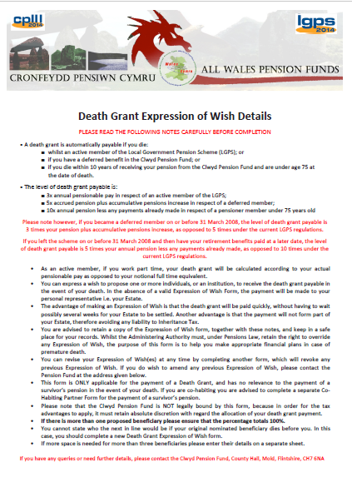
Death Benefits
Death Grant Expression of Wish
It is essential that each member completes a Death Grant Expression of Wish form in respect of the Death Grant for both Death in Service and Death in Pension Lump Sum.
You can nominate one or more individuals or an institution/charity to receive the death grant in the event of your death.
Please request a form today if you have not yet nominated anyone.

Slide 35
Death Benefits
Death in service
Death Grant is three times your actual pay - paid as a lump sum to your nominees.
If no completed form available, money may be paid to your Estate and will await Probate.
Pension Administrators have final discretion.
Death as a Pensioner
10 year guarantee up to age 75
Example – member retires at 65, dies at 70, 5 years pension
remains unpaid, to be paid as Death Grant to your
beneficiaries

Slide 36
Dependants Benefits
Spouses and civil partners are entitled to benefits – these are payable for life even if they remarry or cohabit.
For those members with service on or after 1 April 2008 eligible cohabiting partners are entitled to a survivor’s pension providing certain criteria have been met.
Dependent children’s pensions – may be payable if children are under the age of 18 or if continuing in full-time education/training up to age 23. Disabled children may have the pension paid for life.

Slide 37
Cohabiting Partner’s Pension
-Eligibility Criteria
All for 2 years or more:
You both currently are and have been free to marry/enter a civil partnership with each other
You both have been living together as if you were married /civil partners, and neither you or your cohabiting partner have been living with someone else as if you/they were a married couple or civil partners
Either your cohabiting partner is, and has been, financially dependent on you or you are, and have been, financially interdependent on each other

Slide 38
Retirement Process
Handing in your notice.
Pension Section receives a termination form from your Employer.
Estimate sent to you, together with the Retirement Forms to complete:
Personal details
Certificates requested – Birth, Marriage, Divorce etc.
Bank details
Conversion of pension to lump sum
Declare any other pensions (not State Pension)
Benefits paid out on receipt of completed forms from both you and the employer.

Slide 39
Annual Benefit Statements
Your Annual Benefit Statement should give you an idea of the benefits payable at the end of the last tax year and at your Normal Retirement Age.
The information in the statement is supplied by your employer and is created in a bulk exercise without being manually checked.
Before handing in your notice it is recommended that you contact us by letter or email to request a formal estimate of your pension benefits.

Slide 40
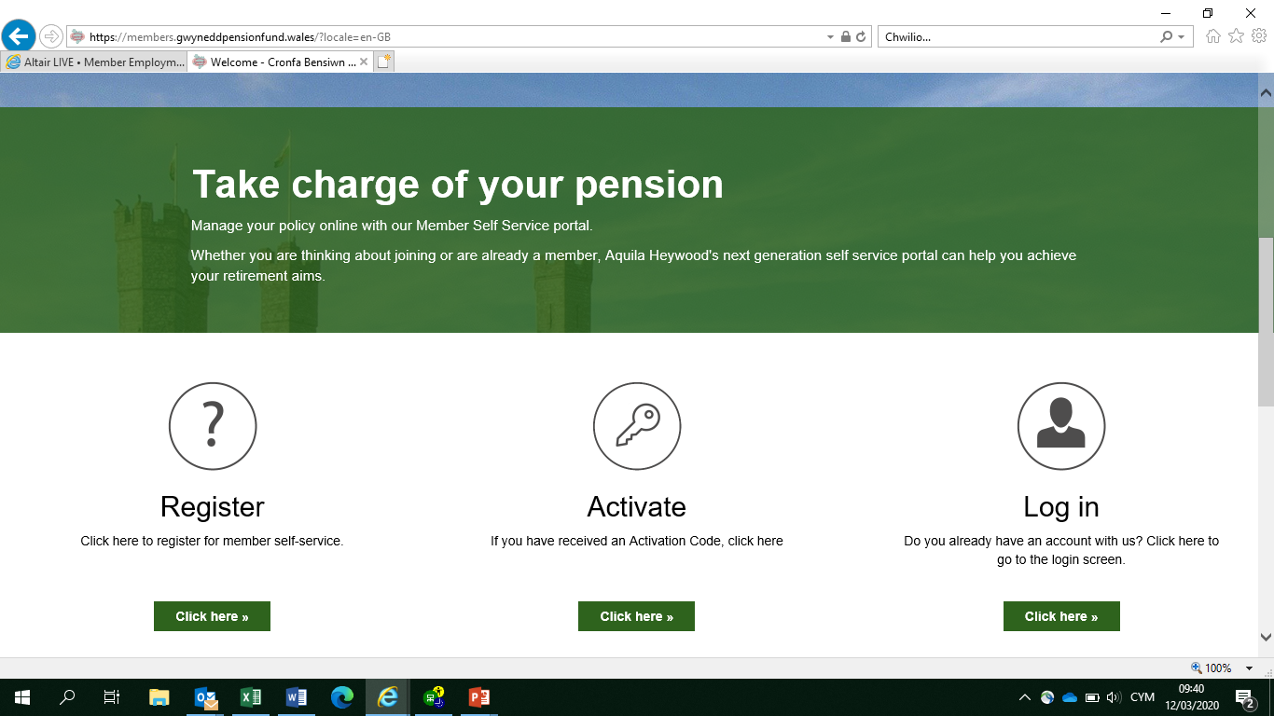
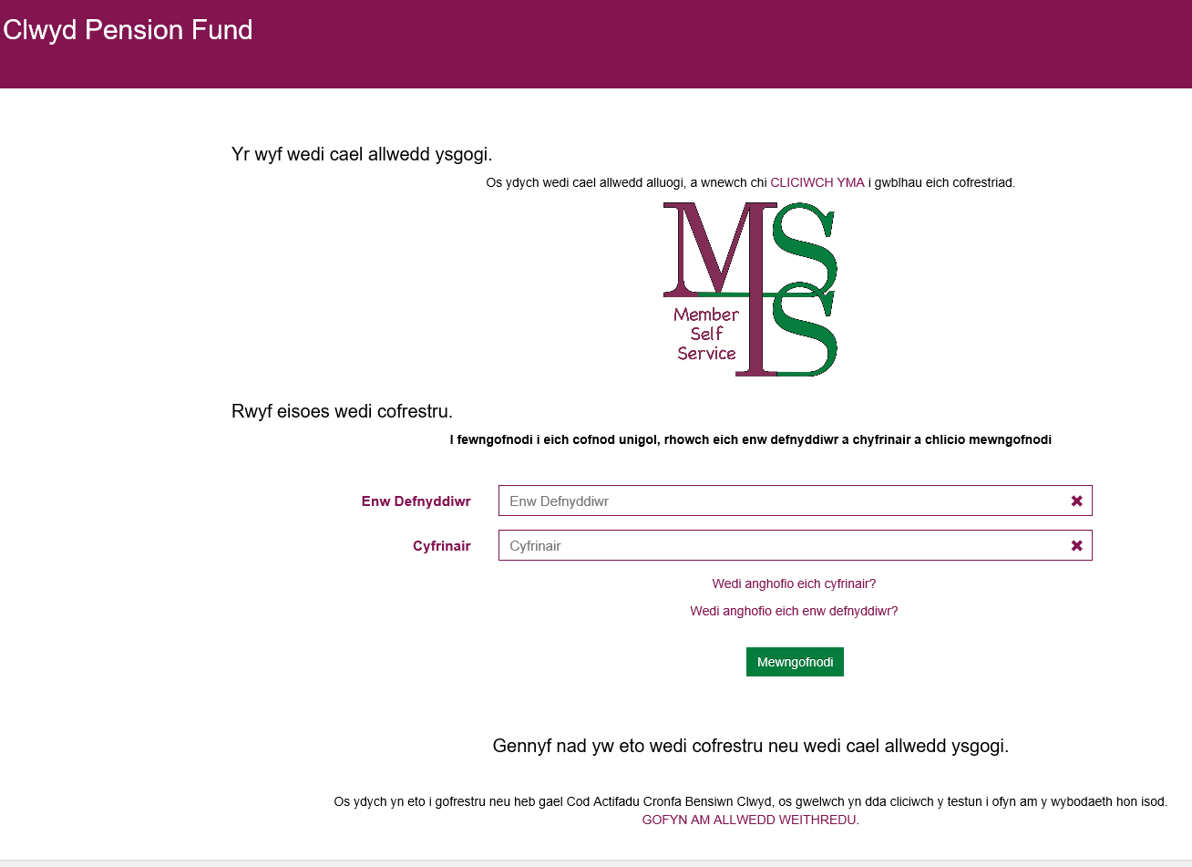
Member Self Service
https://members.gwyneddpensionfund.wales
Once registered, you can:
Run pension projections
View pension details
Update personal details
Contact us
https://mss.clwydpensionfund.org.uk/home/login/

Slide 41
After Retirement
Method of Payment
Pension paid monthly on the last working day of each month for Gwynedd Pension Fund pensioners.
Pension paid on 28th of the month for Clwyd Pension Fund pensioners
Bank credit to bank/building society.
Income Tax
Pensions liable for Tax - 2019/2020 Personal Tax Allowance £12,500
P45 is retained and tax code transferred to pensions payroll on a Month 1 basis
Future tax code changes notified to both pensioner and pensions section.
Any tax queries should be directed to HMRC.
Phone Number: 0300 200 3300 (English) 0300 200 1900 (Welsh)

Slide 42
After Retirement
Pensions might be adjusted annually - index linked. When you receive your pension it will be adjusted each year in line with the cost of living - as currently measured by the Consumer Prices Index (CPI) - to ensure it keeps its value.
Adjustment made each April and payable from age 55 (or any age for ill health or dependant benefits).
          2016 C.P.I. = - 0.1%
          2017 C.P.I. = 1.0%
          2018 C.P.I. = 3.0%
          2019 C.P.I. = 2.4%
Further employment with any employer (LGPS or otherwise) will not affect your pension, unless you have been awarded a previous enhancement e.g. awarded additional years or Tier 1 or 2 ill health enhancements.

Slide 43
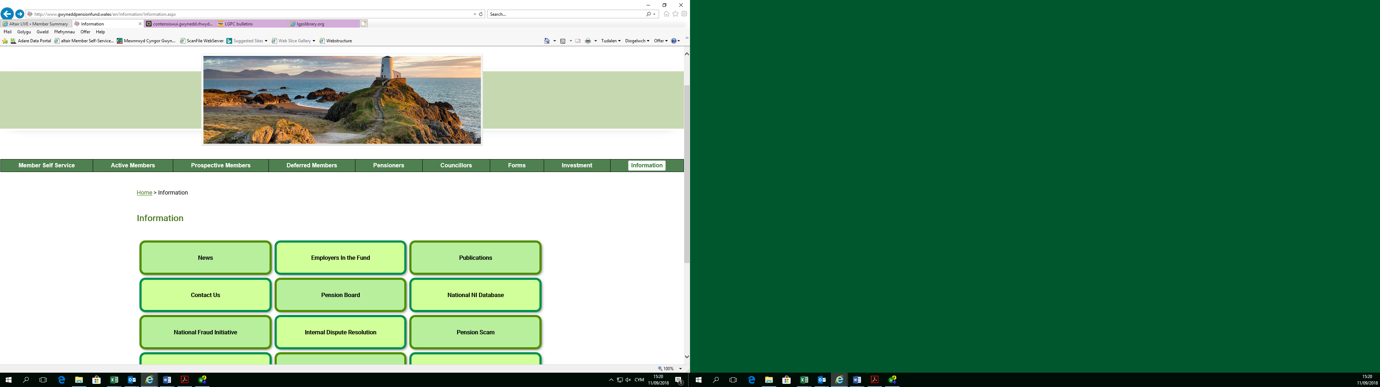
Copies of the slides can be found in the ‘Publications’ page on the Information section of Gwynedd’s website:

Slide 44


Contact Details
Clwyd Pension Fund
Clwyd Pension Fund, County Hall, Mold, Flintshire, CH7 6NA
Tel: 01352 702761
Email: pensions@Flintshire.gov.uk
Website: https://mss.clwydpensionfund.org.uk/
Gwynedd Pension Fund
Gwynedd Pension Fund, Gwynedd Council, Shirehall Street, Caernarfon, LL55 1SH
Tel: 01286 679982
Email: pensions@Gwynedd.llyw.cymru
Website: www.gwyneddpensionfund.wales

